Slide 1
ORIX Leasing Pakistan Limited
CORPORATE BRIEFING
October 27, 2021

Slide 2
Agenda
1
Company Profile
2
Governance
3
Rebranding of the Company
4
Operations
5
Financial Performance
ORIX LEASING PAKISTAN LIMITED | Corporate Briefing Session - Wednesday, October 27, 2021

Slide 3
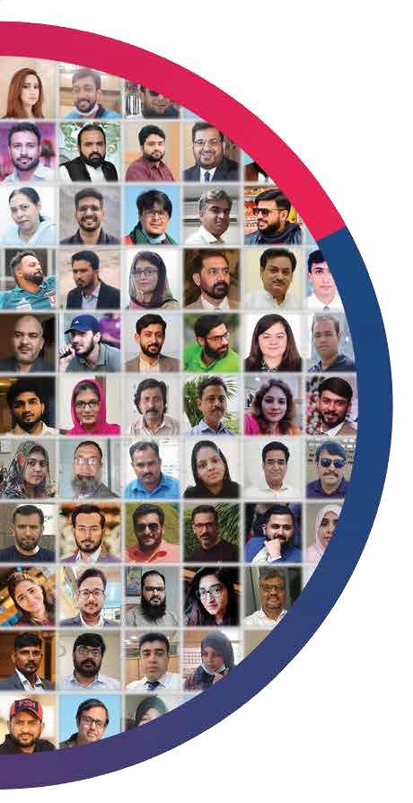
Company Profile
ORIX LEASING PAKISTAN LIMITED | Corporate Briefing Session - Wednesday, October 27, 2021

Slide 4
ORIX Leasing Pakistan Limited – Company Overview
Incorporated
Initial Paid-up Capital
Credit Rating
10 Million
AA+
A1+
Established in July 1986 as a joint venture between ORIX Corporation, Japan and Local investors.
Company is listed on the Pakistan Stock Exchange
Company is headquartered in Karachi and has 38 branches situated in 35 cities
Long Term
Short Term
Paid-up Capital – Jun21
Entity Rating by PACRA: March 03, 2021
8.5 Billion
These are among the
highest ratings in the
Non-Banking Financial
Sector.
First Lease
Total Staff
January 1987
474
ORIX LEASING PAKISTAN LIMITED | Corporate Briefing Session - Wednesday, October 27, 2021

Slide 5
ORIX Leasing Pakistan Limited – Company Overview
Subsidiaries & Associates
Yanal Finance
Company
(formerly Saudi ORIX
Leasing Company) -
Associate
ORIX Services Pakistan
(Private) Limited -
Subsidiary
ORIX Modaraba -
Subsidiary
SAMA Finance SAE -
Held for sale
ORIX LEASING PAKISTAN LIMITED | Corporate Briefing Session - Wednesday, October 27, 2021

Slide 6
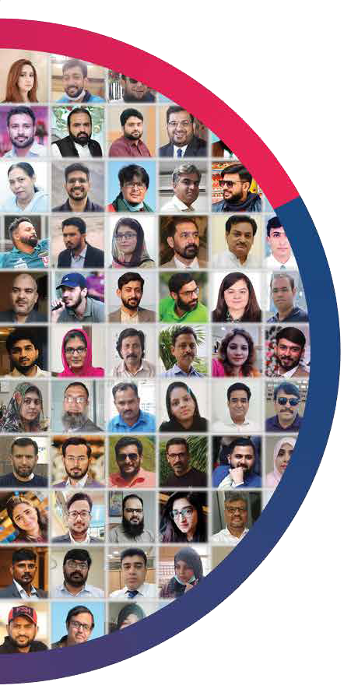
Governance
ORIX LEASING PAKISTAN LIMITED | Corporate Briefing Session - Wednesday, October 27, 2021

Slide 7
Governance Structure
Audit
Committee
MANCOM
HR Nomination and Remuneration Committee
Credit Committee
BOD
CEO
Asset Liability Management Committee
Risk
Committee
Information Technology Steering Committee
Credit
Committee
ORIX LEASING PAKISTAN LIMITED | Corporate Briefing Session - Wednesday, October 27, 2021

Slide 8
OLP’s Risk Management Framework
1ST Line of Defense
2ND Line of Defense
3RD Line of Defense
OLP’s Risk Management Framework is overseen by Board’s Risk Committee and ultimately by the Board. Various Management Committees also oversee each risk.
OLP has also implemented Enterprise Risk Management framework (ERM) to control the risk at strategic level.
The Risk Management Framework consists of three lines of defense
Governance
Risk Management
Compliance
Board approved policies
Internally approved SOPs
Management Committee oversight
Performs both First and Second line defense roles
Is primarily managing credit risk
Checks adherence to laws and regulations
Assesses readiness of Company for potential regulatory changes.
Internal control system
Information Security Officer
Internal Audit
Manual controls implemented through defined SOPs
IT application controls
Reviews gaps in implementation of IT security policies
Advises ITSC on future strategy and corrective measures
Risk based Internal Assurance
ORIX LEASING PAKISTAN LIMITED | Corporate Briefing Session - Wednesday, October 27, 2021

Slide 9
Operations
ORIX LEASING PAKISTAN LIMITED | Corporate Briefing Session - Wednesday, October 27, 2021

Slide 10
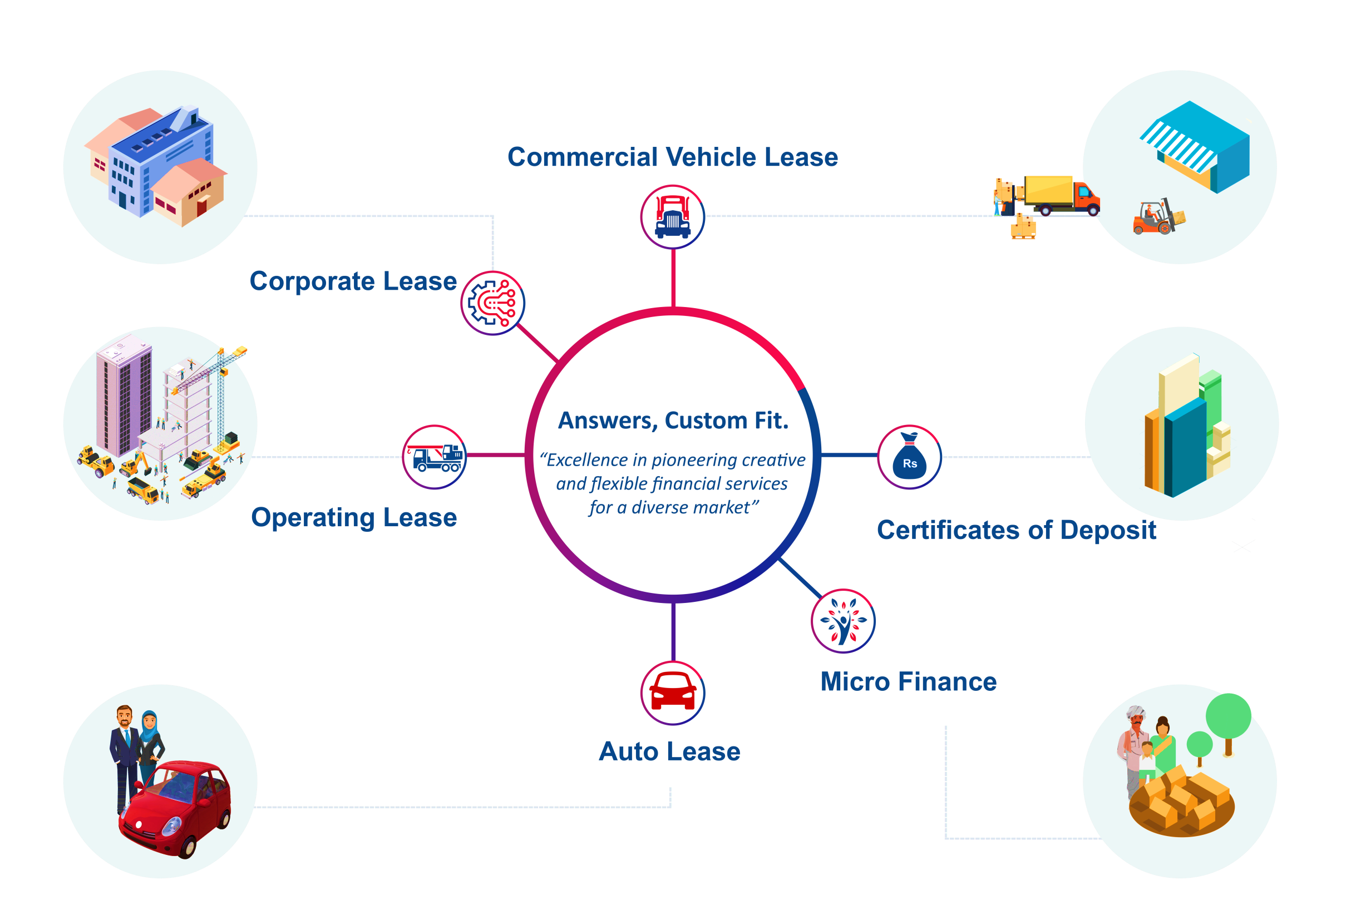
OLP Products
ORIX LEASING PAKISTAN LIMITED | Corporate Briefing Session - Wednesday, October 27, 2021

Slide 11
OLP Strategy
OLP focus will be on increasing its
client base
Alliances with vendors / manufacturers for co-marketing
Product diversification to take advantage of IFS license
Product differentiation
to retain
competitiveness
Emphasis on
transparency
ORIX LEASING PAKISTAN LIMITED | Corporate Briefing Session - Wednesday, October 27, 2021

Slide 12
Distribution Zones
FAISALABAD
HYDERABAD
ISLAMABAD
JHANG
SAHIWAL
SARGODHA
SUKKUR
CHAKWAL
MIRPUR
RAWALPINDI
TALAGANG
TAXILA
KARACHI
CLIFTON
KHALID BIN WALEED
LAHORE
KOT ABDUL MALIK
THOKAR NIAZ BAIG
MULTAN
BAHAWALPUR
RAHIM YAR KHAN
VEHARI
PESHAWAR
ABBOTABAD
KOHAT
MINGORA
SIALKOT
GUJRANWALA
GUJRAT
MICRO FINANCE
JALLO MORRE
KOT ABDUL MALIK
MORE KHUNDA
SHARQPUR
CHUNIAN
MANGA MANDI
PATTOKI
RENALA KHURD
BHALWAL
SILLANWALI
SHAHPUR
PESHAWAR-MFD
SARGODAH-MFD
MINGORA-MFD
SAHIWAL-MFD
ORIX LEASING PAKISTAN LIMITED | Corporate Briefing Session - Wednesday, October 27, 2021

Slide 13
Financial Performance
ORIX LEASING PAKISTAN LIMITED | Corporate Briefing Session - Wednesday, October 27, 2021

Slide 14
ORIX Leasing Pakistan Limited – Performance Highlights
FY
2018
FY
2017
FY
2019
FY
2021
FY
2020
Cash Dividend: Rs. 481M (30%) Bonus Shares: Rs. 278M (20%)
Debt to equity: 2.35 times
EPS: Rs. 8.40/share
PAT: Rs.1,380M
Cash Dividend: Rs. 417M (30%)
EPS: Rs. 9.42/share
PAT: Rs.841M
Debt to equity: 4.34 times
Cash Dividend: Rs. 626M (37.5%)
Debt to equity: 1.95 times
EPS: Rs. 6.12/share
PAT: Rs. 1,023M
Cash Dividend: Rs. 702M (40%)
Debt to equity: 1.65 times
EPS: Rs. 5.22/share
PAT: Rs. 915M
Cash Dividend: Rs. 543M (32.5%) Bonus Shares: Rs. 84M
(5%)
Debt to equity: 1.56 times
EPS: Rs. 4.00/share
PAT: Rs. 702M
ORIX LEASING PAKISTAN LIMITED | Corporate Briefing Session - Wednesday, October 27, 2021

Slide 15
Performance Highlights
2017
2018
2019
2020
2021
Disbursement
Rs. in Billion
15.0
17.2
13.9
9.1
16.5
No. of Contracts
3,180
3,289
2,703
1,627
2,813
No. of Customers
7,039
7,128
6,839
5,913
5,553
ORIX LEASING PAKISTAN LIMITED | Corporate Briefing Session - Wednesday, October 27, 2021

Slide 16
Performance Highlights
Sector | Portfolio (Rs. in ‘000)
Individuals | 5,836,190
Goods Transport | 2,721,547
Public Transport | 1,594,143
Distributor | 1,576,814
Services | 1,474,531
Textile & Allied | 1,370,689
Trading | 1,241,977
Fuel & Energy | 929,843
Food & Allied | 644,339
Glass, Ceramics & Plastic | 521,387
Others | 3,677,559
Total | 21,589,019
ORIX LEASING PAKISTAN LIMITED | Corporate Briefing Session - Wednesday, October 27, 2021

Slide 17
Financial Performance
Profit or Loss Amount in Rs. million | 2017 | 2018 | 2019 | 2020 | 2021
Income from operations | 3,434 | 3,478 | 3,856 | 4,048 | 3,278
Other income | 368 | 896 | 273 | 359 | 368
Share of profit from associates | 229 | 98 | 51 | 28 | 35
Total income | 4,031 | 4,472 | 4,180 | 4,435 | 3,681
Finance cost | 1,586 | 1,390 | 1,542 | 1,845 | 1,194
Administrative, general and other expenses | 1,369 | 1,344 | 1,371 | 1,293 | 1,221
Provisions / (reversal in provision) – net | (82) | 18 | (181) | 324 | (18)
Total expenditure | 2,873 | 2,752 | 2,732 | 3,462 | 2,397
Profit before tax | 1,158 | 1,720 | 1,448 | 973 | 1,284
Taxation | 317 | 340 | 425 | 271 | 369
Profit after tax | 841 | 1,380 | 1,023 | 702 | 915
EPS | 9.42 | 8.40 | 6.12 | 4.00 | 5.22
Share Price as of Jun 30, | 40 | 43 | 25 | 23 | 26
ORIX LEASING PAKISTAN LIMITED | Corporate Briefing Session - Wednesday, October 27, 2021

Slide 18
Financial Performance
Statement of Financial Position Amounts in Rs. million | June 2017 | June 2018 | June 2019 | June 2020 | June 2021
Net investment in finance lease | 16,743 | 17,917 | 17,287 | 13,488 | 13,209
Finances and loans | 3,605 | 4,460 | 4,714 | 4,501 | 7,526
Investments | 3,635 | 2,341 | 2,375 | 2,772 | 2,278
Other assets | 2,112 | 1,981 | 1,615 | 2,238 | 1,773
Total Assets | 26,096 | 26,699 | 25,991 | 22,999 | 24,786
Equity | 4,466 | 7,249 | 8,013 | 8,234 | 8,526
Bank borrowings | 13,343 | 11,774 | 11,387 | 8,454 | 9,203
Certificates of deposit | 6,028 | 5,276 | 4,259 | 4,407 | 4,869
Other liabilities | 2,258 | 2,400 | 2,332 | 1,904 | 2,187
Total Equity and Liabilities | 26,096 | 26,699 | 25,991 | 22,999 | 24,786
ORIX LEASING PAKISTAN LIMITED | Corporate Briefing Session - Wednesday, October 27, 2021

Slide 19
Financial Performance
ORIX LEASING PAKISTAN LIMITED | Corporate Briefing Session - Wednesday, October 27, 2021

Slide 20
Financial Performance
ORIX LEASING PAKISTAN LIMITED | Corporate Briefing Session - Wednesday, October 27, 2021

Slide 21
Financial Performance
Amount in Rs. millions
Borrowing | 19,371 | 17,050 | 15,645 | 12,861 | 14,072
D/E Ratio (times) | 4.34 | 2.35 | 1.95 | 1.56 | 1.65
ORIX LEASING PAKISTAN LIMITED | Corporate Briefing Session - Wednesday, October 27, 2021

Slide 22
Financial Performance
ORIX LEASING PAKISTAN LIMITED | Corporate Briefing Session - Wednesday, October 27, 2021

Slide 23
Rebranding of
the Company
ORIX LEASING PAKISTAN LIMITED | Corporate Briefing Session - Wednesday, October 27, 2021

Slide 24
Rebranding of the Company
OLP’s Board of Directors has decided to rebrand the Company in line with the Company’s vision of enhancing its corporate image as an SME focused financial services company. The proposed new name of the Company is:
ORIX LEASING PAKISTAN LIMITED
OLP FINANCIAL SERVICES PAKISTAN LIMITED
* This change is subject to regulatory approval.
ORIX LEASING PAKISTAN LIMITED | Corporate Briefing Session - Wednesday, October 27, 2021

Slide 25
Rebranding of the Company
OLP has traditionally focused on the leasing of productive plant and machinery and transportation assets. Over the past 35 years, OLP has played an important role in the development of the leasing industry in Pakistan and is currently the largest player in the leasing industry.
OLP has upgraded its leasing license to an Investment Finance Services license which allows the Company to significantly broaden its product portfolio.
The Board is of the view that a change in the Company’s name is an essential step in developing the Company’s image as a multi-product innovative financial institution rather than simply a leasing company. The new name reflects the Company’s focus on providing full spectrum of financial services to its customers with particular emphasis on serving the needs of the SME sector.
ORIX Corporation, OLP’s principal shareholder, fully endorses the rebranding and remains wholly committed to OLP and its growth strategy.
ORIX LEASING PAKISTAN LIMITED | Corporate Briefing Session - Wednesday, October 27, 2021

Slide 26
Thank You

